Slide 1

Lambert Air Management System
Sign In
Home
Admin
Quote
About
Because Bruce can’t drive.
Why LAMS?
Proposed Solution
……………………………………………………..
……………………………………………………..
……………………………………………………..
……………………………………………………..
Lambert Air Management System aims to manage all your incoming and outgoing flights through integration of a modern software system.
READY TO DEPLOY NOW!
More benefits include:
Increase revenue by increasing efficiency and throughput
Minimize lost time for arriving and departing passengers, maximizing customer satisfaction

Slide 2
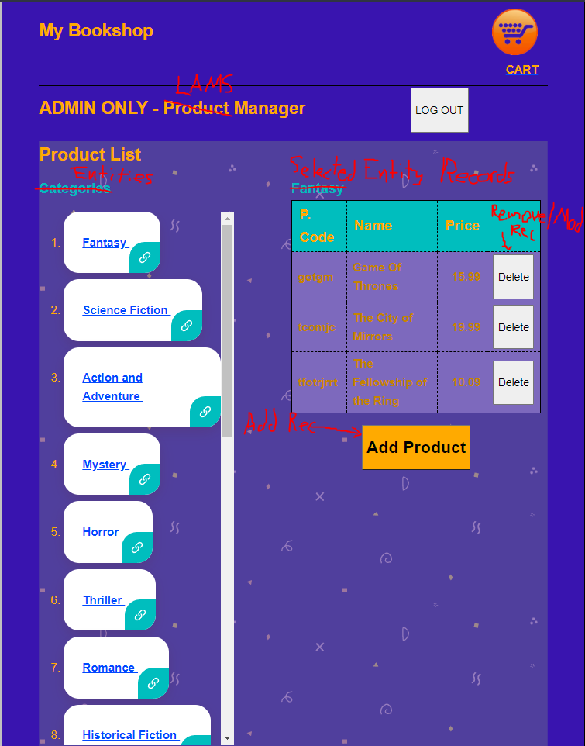

Lambert Air Management System
Sign In
Home
Admin
Quote
About
Each entity listing – when clicked it brings up a table, where you can ADD/MODIFY/DELETE
NEED ACCESS
Example of what it will eventually look like, with some UI differences.

Slide 3
Lambert Air Management System
Sign In
Home
Admin
Quote
About
Contacting a member of the LAMS team
Andrew Daur / INSERT TITLE
email: ad1297@usnh.com
Matthew Lavin / INSERT TITLE
email: matthew.lavin@keene.edu
Joshua Snider / INSERT TITLE
email: joshuas_nh@yahoo.com
Elvis Foster / ADVISOR
email: efoster@keene.edu
Request a Quote Today
*Name:
your name
*Email:
your email
*Company:
ProfileID:
SEND

Slide 4

Lambert Air Management System
Sign In
Home
Admin
Quote
About
Our Company
…………………………….
Current Partners
………………………………..
Product Reviews
………………………………..
Need help?
Search for answers
Frequently Asked Questions
How much does LAMS cost?
What can I run LAMS on?
I’m having trouble implements LAMS.
How do I upgrade my account?

Slide 5


Lambert Air Management System
Sign In
Home
Admin
Quote
About
Pop-up when the Sign in button in clicked, and the user is currently signed in.
Pop-up when the Sign in button in clicked, and the user has not yet signed in.
USER_LAMS
DISPLAY CLEARANCE ACCESS
IF USER HAS THE BASE PACKAGE DISPLAY
“Upgrade your account”
Sign Out
Sign Up for LAMS
Join to manage your airport, personnel, and flights
Reasons to Join
Upgrade your account
Sign In
Join today

